Slide 1


Department of Information Technology
V R Siddhartha Engineering College
Change Detection on Satellite images using Deep learning techniques
(AI/ML/DL)
B.Tech in Information Technology
MINI Project Review Presentation
Presented by
Mr. Ajay Kumar Varma Nagaraju (208W1A12A1)
Ms. Latha Sri Pallapati (218W5A1209)
Under the guidance of
Dr. M. Suneetha, Hod IT

Slide 2
Agenda
Introduction
Problem Definition
Objectives and Outcomes
Summary of Literature review
Dataset Description
Architecture diagram
Algorithms/Procedure
Implementation Plan
Result and analysis
Conclusion
References

Slide 3
Problem Statement
Detection of changes in satellite images and to identify land cover changes over a period of time in that satellite images.
To detect the changes we want to compute a change map CM. The change map CM is a binary map where the value of a pixel is 1 if a change is detected and 0 otherwise.

Slide 4
Title of the Project
“Change Detection on Satellite Images using Deep Learning Techniques”.
Abstract
Change detection is a classical problem in satellite imaging. The purpose of CD is to accurately identify changes on the Earth’s surface. However, most CD methods focus on changes between the pixels of multitemporal remote sensing image pairs while ignoring the coupled relationships between them. The changes to be analysed can be various: cloud detection, appearance of roads and buildings, deforestation monitoring or agricultural crop monitoring. A broad range of methods used to identify, describe, and quantify differences between images of the same scene at different times or under different conditions.

Slide 5
Objectives
Design and develop a model for effective change detection in given satellite image.
Recognizing the geographical location and type of changes, quantifying the changes, and assessing the accuracy of change detection results.
Outcomes
A consistent model that accurately detects changes in a given region. Also, shows changes over time in a particular region.
Improved urban planning and decision making related to development in a region.

Slide 6
LITERATURE REVIEW
Sno | Paper | Methodology | Year | Algorithm | Observation
1 | A Deep Learning Model for Change Detection on Satellite Images | They developed a model for detection of changes in satellite images. They used OSCD dataset to train and test their model. | 2022 | Convolutional Neural Networks | They got 96% Global Accuracy with FC-EF Architecture. The precision and Recall values are 64% and 50% respectively.
2 | A Change Detection Method for Remote Sensing Images Based on Coupled Dictionary and Deep Learning | They have developed model based on Couple Dictionary Learning . The dictionaries used to sparsely represent difference between images. | 2023 | Couple Dictionary Learning, FC-EF, FCN-PP, FC-Siam-Conc , FC-Siam-Diff , CDNet , CD-UNet ++ , and GANs | They got 98% Accuracy with their proposed methodology.

Slide 7
Sno | Paper | Methodology | Year | Algorithm | Result
3 | A 3d CNN Approach For Change Detection In Hr Satellite Image Time Series Based On A Pretrained 2d CNN. | They developed model for change detection in HR Satellite image time series. Their approach is unsupervised change detection. 3D CNN feature extraction is done. | 2022 | Three Dimensional CNN | They obtained varying time series of false alarms and missing alarms. That is overall of 14% pixels got false alarms.
4 | Single-Temporal Supervised Object Change Detection in Remote Sensing Imagery | They developed model for change detection. They used neural network architecture named Change Star which a segmentation model and Change Mixing module | 2021 | CNN , Conv Net , Simple Temporal supervised learning (STAR) | They made comparison between Bi-Temporal and Single temporal supervised learning. They obtained 91% IoU With Bitemporal.
5 | 3M-CDNet-V2: An Efficient Medium-Weight Neural Network for Remote Sensing Image Change Detection | The authors proposed methodology for change detection using 3M-CDNet-V2 architecture. They used Self-Attention layer which gives output feature map. | 2022 | 3D-CDNet-V2,CNN | The model achieved 88% IOU with CDD dataset. 71% IOU with PIESAT-CD dataset. 62% IOU with CD data GZ dataset.

Slide 8
Dataset description
OSCD ( Onera Satellite Change Detection) - Sentinel-2
The Onera Satellite Change Detection dataset addresses the issue of detecting changes between satellite images from different dates.
It comprises 24 pairs of multispectral images taken from the Sentinel-2 satellites between 2015 and 2018. Locations are picked all over the world, in Brazil, USA, Europe, Middle-East and Asia. For each location, registered pairs of 13-band multispectral satellite images obtained by the Sentinel-2 satellites are provided. Images vary in spatial resolution between 10m, 20m and 60m.
Pixel-level change ground truth is provided for all 14 training and 10 test image pairs. The annotated changes focus on urban changes, such as new buildings or new roads. These data can be used for training and setting parameters of change detection algorithms.

Slide 9
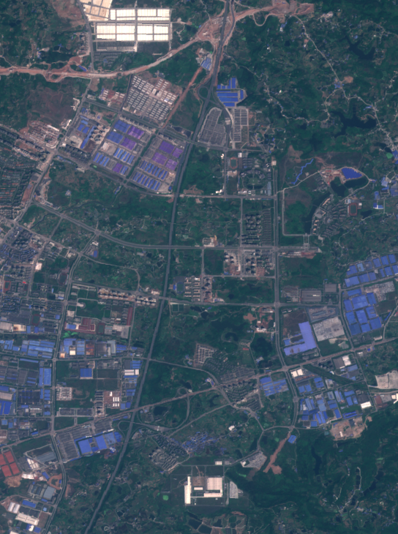
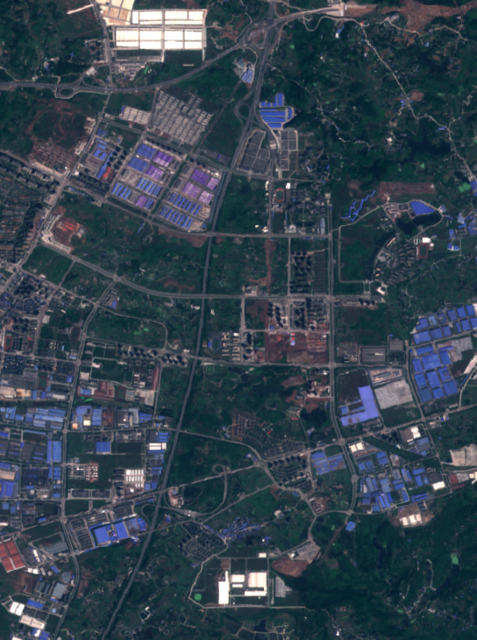
The above two images are of location called Chongqing in China. First image is Chongqing in the year 2015 and the second image is Chongqing in the year 2018.

Slide 10
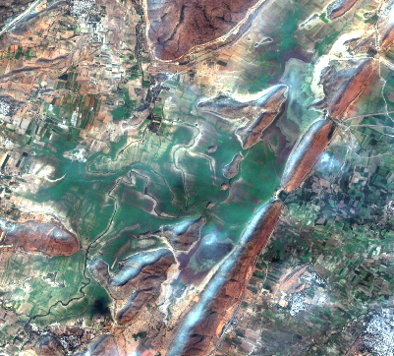
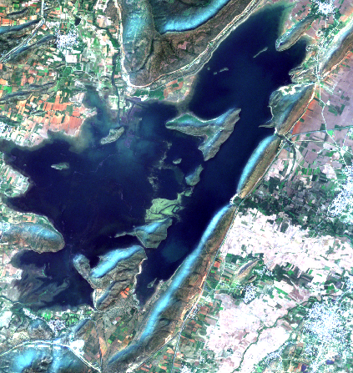
Fig. Sentinal-2 satellite image of Cumbum region in timestamps 2019 and 2022

Slide 11
Requirements of the Project
User Requirements(Dataset):
Google earth engine.
Sentinal 2 Satellite data – OSCD.
IEEE Dataport.
Functional Requirements:
Python Programming Language.
TensorFlow, Keras Python Libraries.
System Requirements:
Software : Google Colab.
Os: Windows/Linux/Mac
Configuration: RAM 8GB with GPU.
Model Evaluation Measures:
Accuracy
Precision
Recall

Slide 12
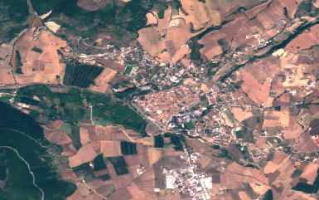

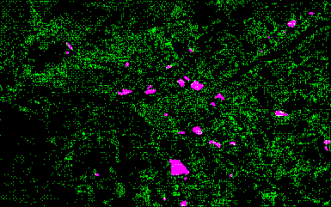
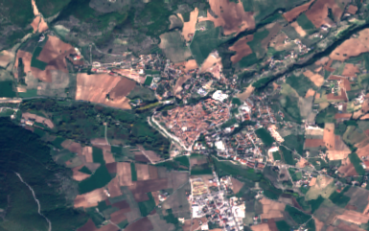
Architecture diagram
Feature Maps 1
Pixel-wise Change Computation
Fully Convolution Network
Time Stamp 1
Feature Maps 2
Reference Map
Change Map
Time Stamp 2

Slide 13
Algorithm: FCNN
Input: Two satellite images, I1 and I2, of size H x W x C
Output: A binary change map, M, of size H x W
Define the network architecture:
a. Input layer with H x W x C dimensions
b. Several convolutional layers with ReLU activation
c. Max-pooling layers
d. Up-Sampling layers
e. Output layer with sigmoid activation.
2. Initialize the weights of the network randomly.

Slide 14
3. Define a loss function, L, to measure the difference between the predicted change map and the ground truth change map:
L = -1/N * sum_i (y_i*log(p_i) + (1-y_i)*log(1-p_i))
where N is the number of pixels in the change map, y_i is the ground truth label (0 or 1), and p_i is the predicted probability of change.
4. Train the network:
a. Feed the two input images, I1 and I2, to the network
b. Calculate the output change map, M, using the sigmoid activation function
c. Compute the loss, L, using the predicted change map, M, and the ground truth change map
d. Backpropagate the error through the network to update the weights using stochastic gradient descent or another optimizer
e. Repeat steps b-d for multiple epochs until the loss converges

Slide 15
5. Evaluate the network:
a. Feed the two input images, I1 and I2, to the network
b. Calculate the output change map, M, using the sigmoid activation function
c. Threshold the change map, M, to obtain a binary map, B, using a threshold value, t
d. Compare the binary map, B, with the ground truth change map to evaluate the performance of the network using metrics such as accuracy, precision, and recall
6. Use the trained network to detect changes in new satellite images by repeating step 5 with the new images.
7. End
Note: This algorithm assumes that the two input images, I1 and I2, are pre-processed to have the same spatial resolution and that the ground truth change map is available for training and evaluation.

Slide 16
Implementation Steps
Initially, the images are downloaded or gathered from google earth engine in Tif format. Download them and load them in QGIS.
Extract all 13 bands into individual Tif file. At the time of model training the Tif’s can be loaded individually based on user’s requirement either 3 or 13 bands.
Feed two images to model of two different two time stamps and then the model as per specified bands considers the number of channels (here the number of channels is count of number of bands specified by user).
The Unet, F-res-Unet, Siamese conc and Siamese diff Architectures anyone among these can be chosen.
The images are passed as input to FCNN (any one of above Architectures) so after performing pixel based change mapping it will generate a change map.
The change map is final detection by the model. It is then compared pixel wise with Original Reference map in order to know what percentage of changes was correctly detected by the developed model.
Here, Accuracy, Precision and Recall are used to Judge the model’s Performance.

Slide 17
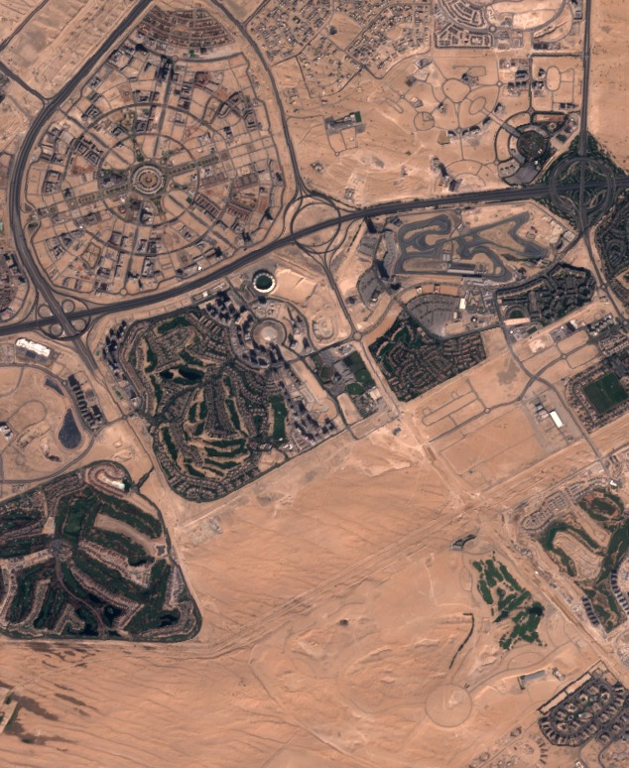
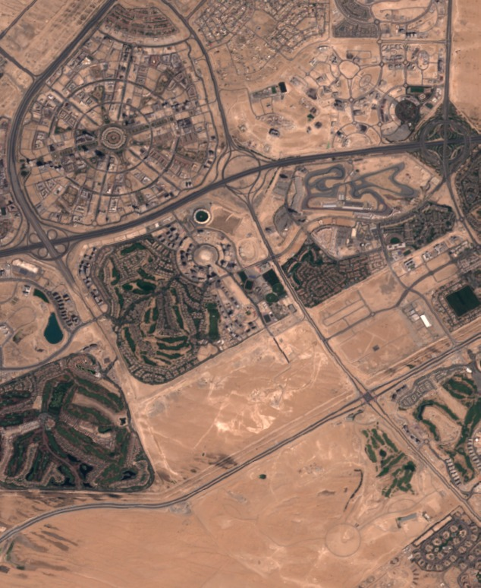
Test case 1 results
2018 image
2015 image

Slide 18
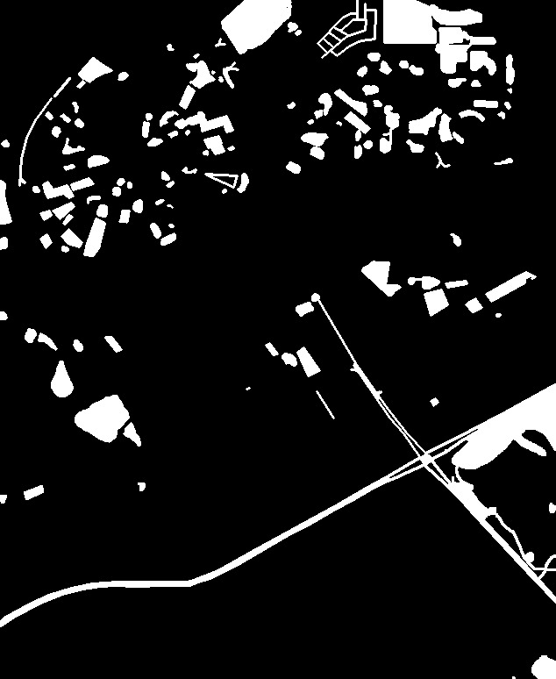
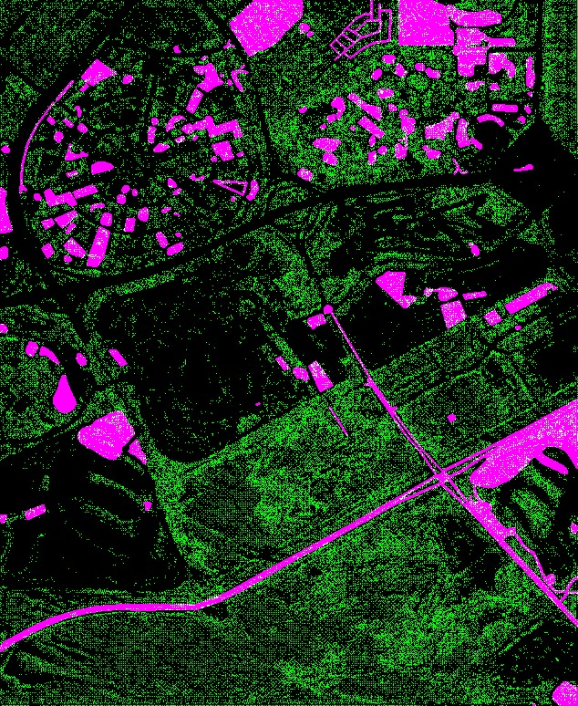
Test case 1results
Output predicted by the model
Ground Truth

Slide 19
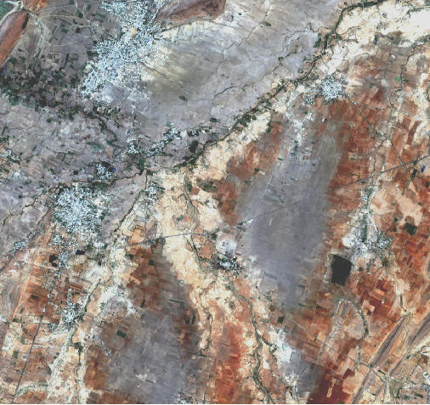
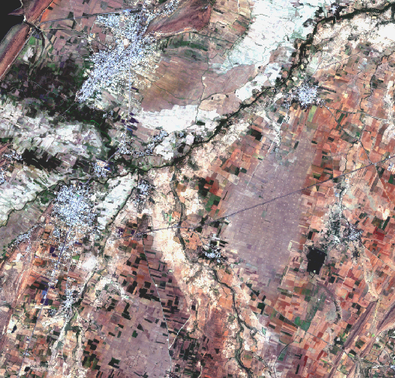
Test case 2 results
2022 image
2019 image

Slide 20
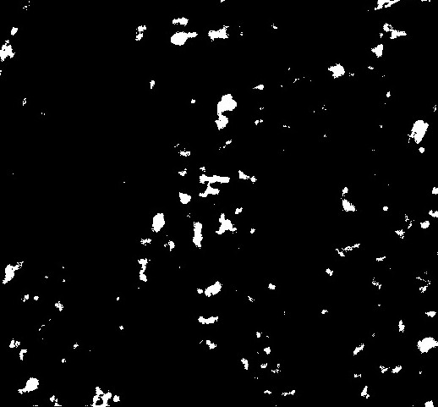
TEST CASE 2 RESULTS
Change map given by the model with FCNN algorithm for above two images of test case 2.

Slide 21
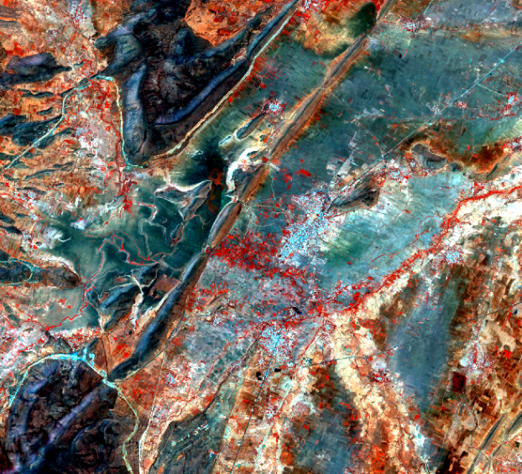
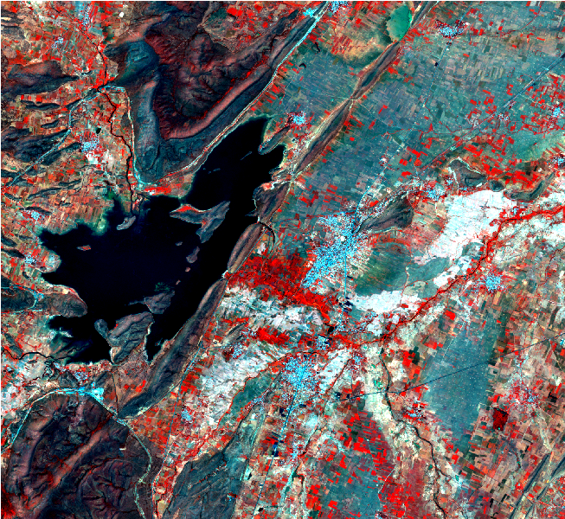
Test case 3 results
2019 image
2022 image

Slide 22
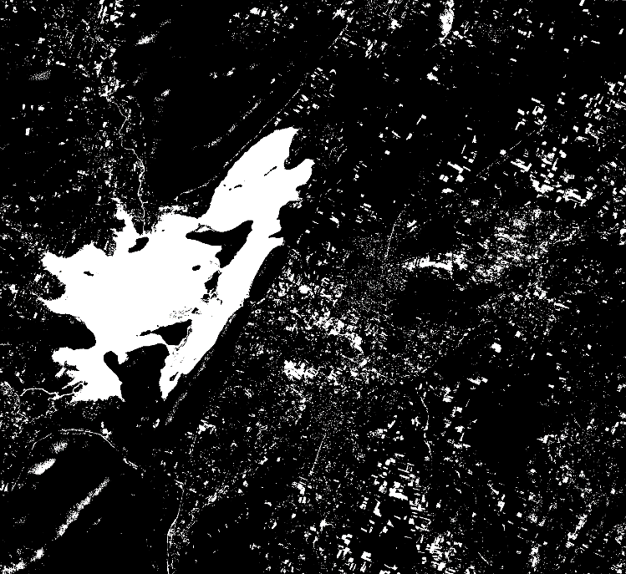
Test case 3 results
Change map given by the model with slow feature analysis algorithm for above two images of test case 3.

Slide 23
PERFORMANCE OF THE MODEL WITH DIFFERENT ARCHITECTURES (ANALYSIS)
Network Architecture | Accuracy | Precision | Recall
FC-EF | 93% | 86% | 88%
Siamese Conc | 89% | 78% | 80%
Siamese Diff | 90% | 83% | 83%
FC-EF Res | 94% | 86% | 85%
FC-EF Res 2 | 95% | 87% | 86%
The Fully Convolutional Early Fusion Network Architecture is giving more Accuracy of than Siamese Network Architecture. The above test cases are done with images with 13 Bands.

Slide 24
conclusion
In conclusion, our project was successful in detecting changes in satellite photos between two timestamps using a fully convolutional neural network (FCNN). We were successful in accurately detecting changes, notably in urban areas like new buildings and roads, by training the FCNN model using the OSCD dataset.
From the selected architectures FC-EF Res 2and FC-EF Res are performing well with the accuracy of 95% and 94% respectively. So same architecture can be employed for detecting changes in Cumbum region as well.
The use of deep learning techniques for satellite image analysis has the potential to revolutionize the field and provide valuable insights for decision-making processes.

Slide 25
References
Elyes Ouerghi “A Deep Learning Model for Change Detection on Satellite Images, Image Processing On Line”, 12 (2022), pp. 550–557. https://doi.org/10.5201/ipol.2022.439 ,2022
Weiwei Yang et al. “A Change Detection Method for Remote Sensing Images Based on Coupled Dictionary and Deep Learning,” pp-1687-5265 https://doi.org/10.1155/2022/3404858 , 2023
Meshkini et al. “A 3D CNN APPROACH FOR CHANGE DETECTION IN HR SATELLITE IMAGE TIME SERIES BASED ON A PRETRAINED 2D CNN”, Int. Arch. Photogramm. Remote Sens. Spatial Inf. Sci., XLIII-B3-2022, 143–150, https://doi.org/10.5194/isprs-archives-XLIII-B3-2022-143-2022, 2022.
B. Zhao et al"3M-CDNet-V2: An Efficient Medium-Weight Neural Network for Remote Sensing Image Change Detection," in IEEE Access, vol. 10, pp. 89581-89597, 2022, doi: 10.1109/ACCESS.2022.3201129.
Zheng, Zhuo et al. “Change is Everywhere: Single-Temporal Supervised Object Change Detection in Remote Sensing Imagery.” 2021 IEEE/CVF International Conference on Computer Vision (ICCV) (2021): 15173-15182.

Slide 26
Thank You

